Slide 1
Chapter 3

Slide 2
Shielding by isotropic groups

Slide 3
Ring currents

Slide 4
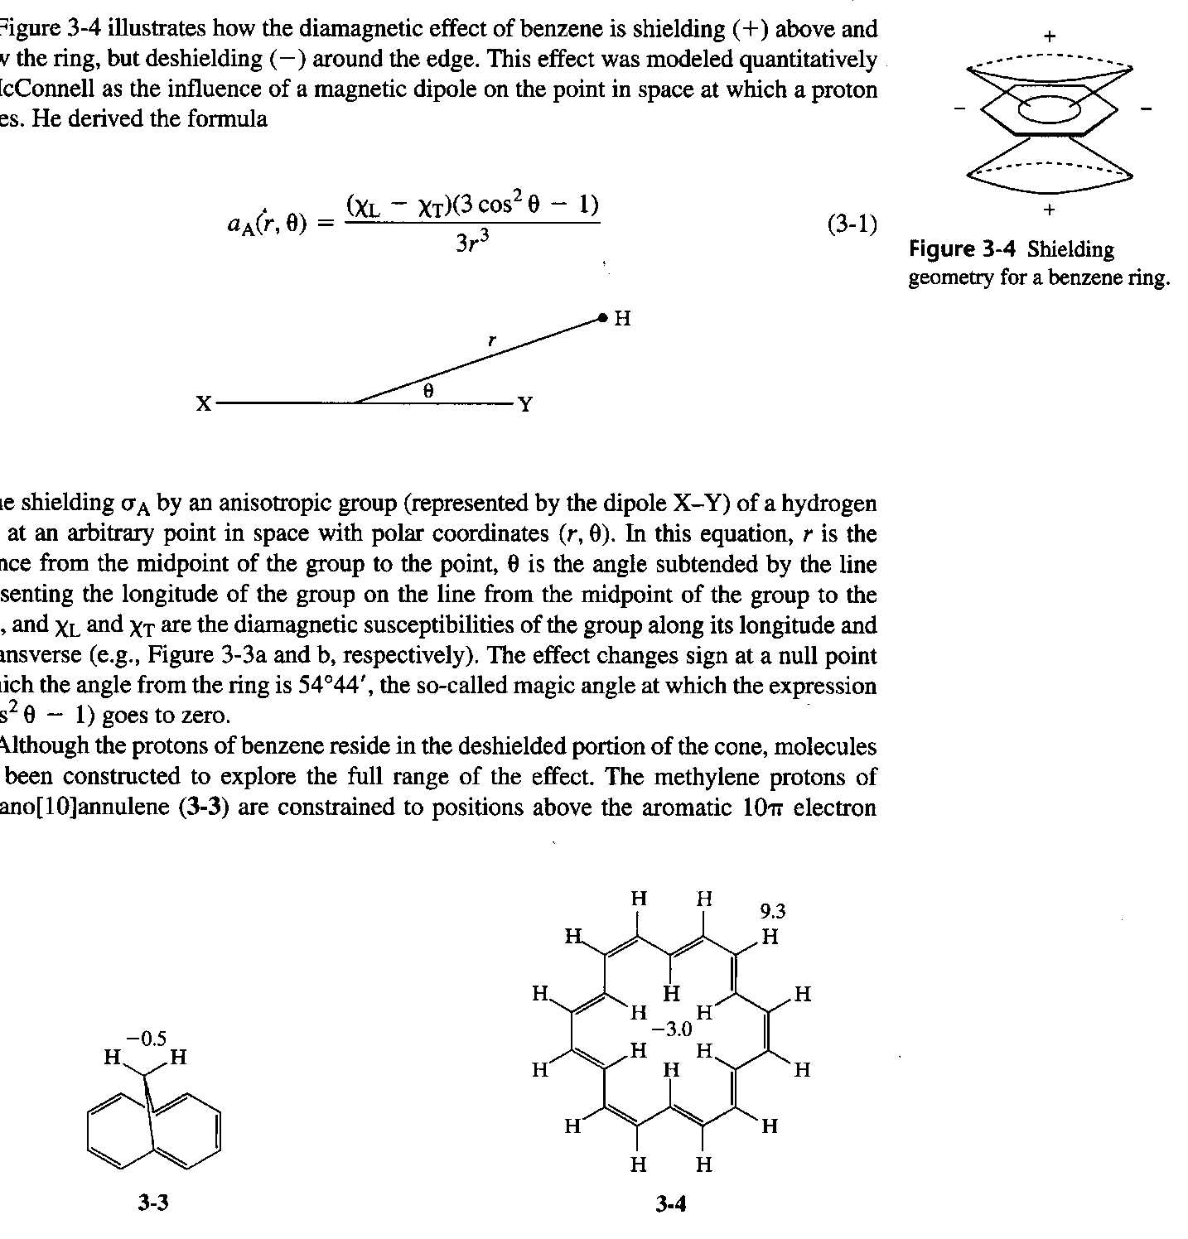
Ring currents

Slide 5
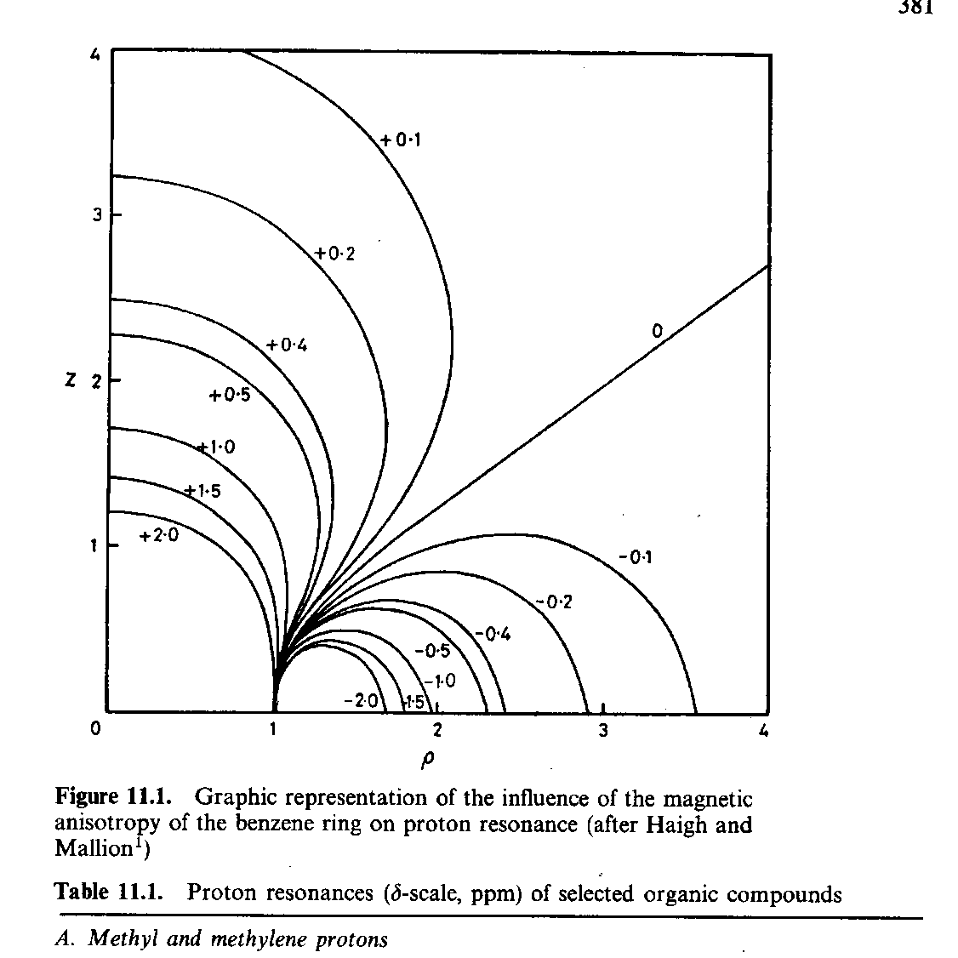
Johnson-Bovey map

Slide 6
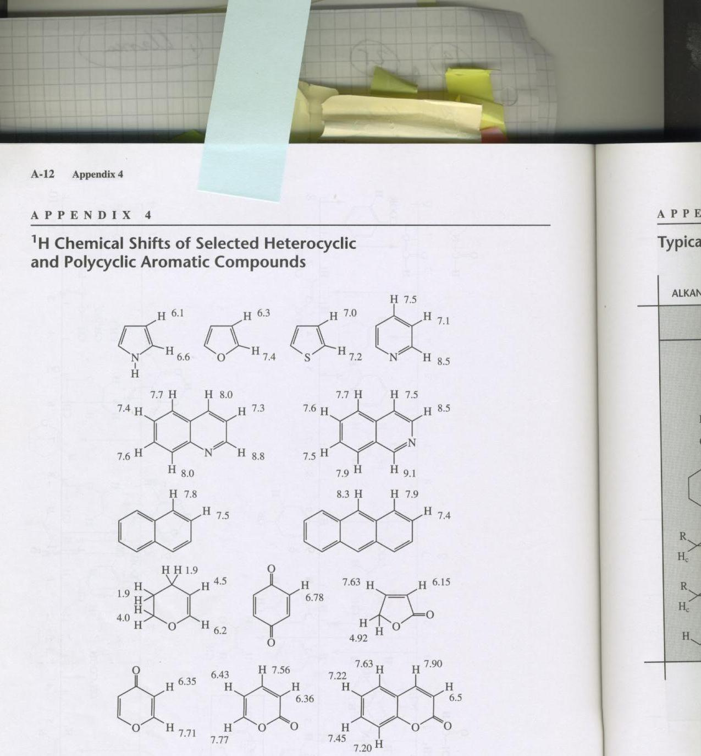

Slide 7
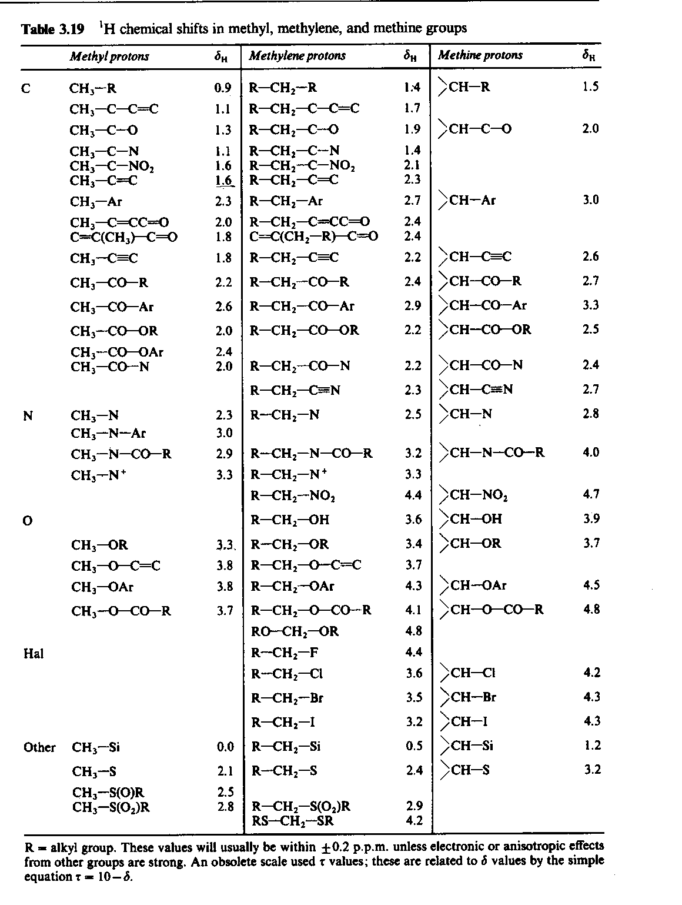

Slide 8
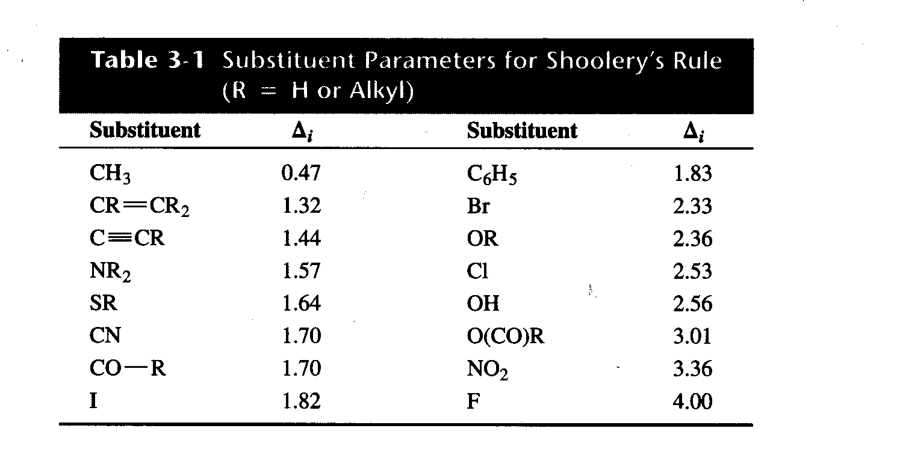

Slide 9
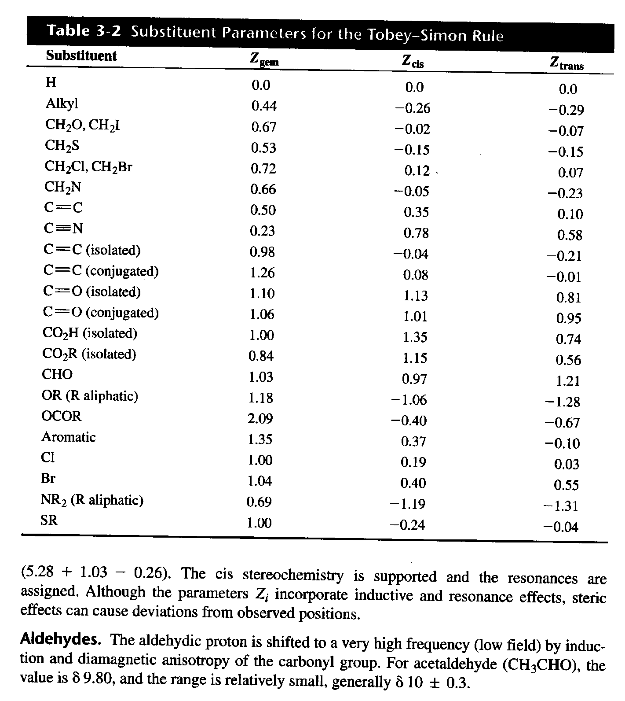

Slide 10
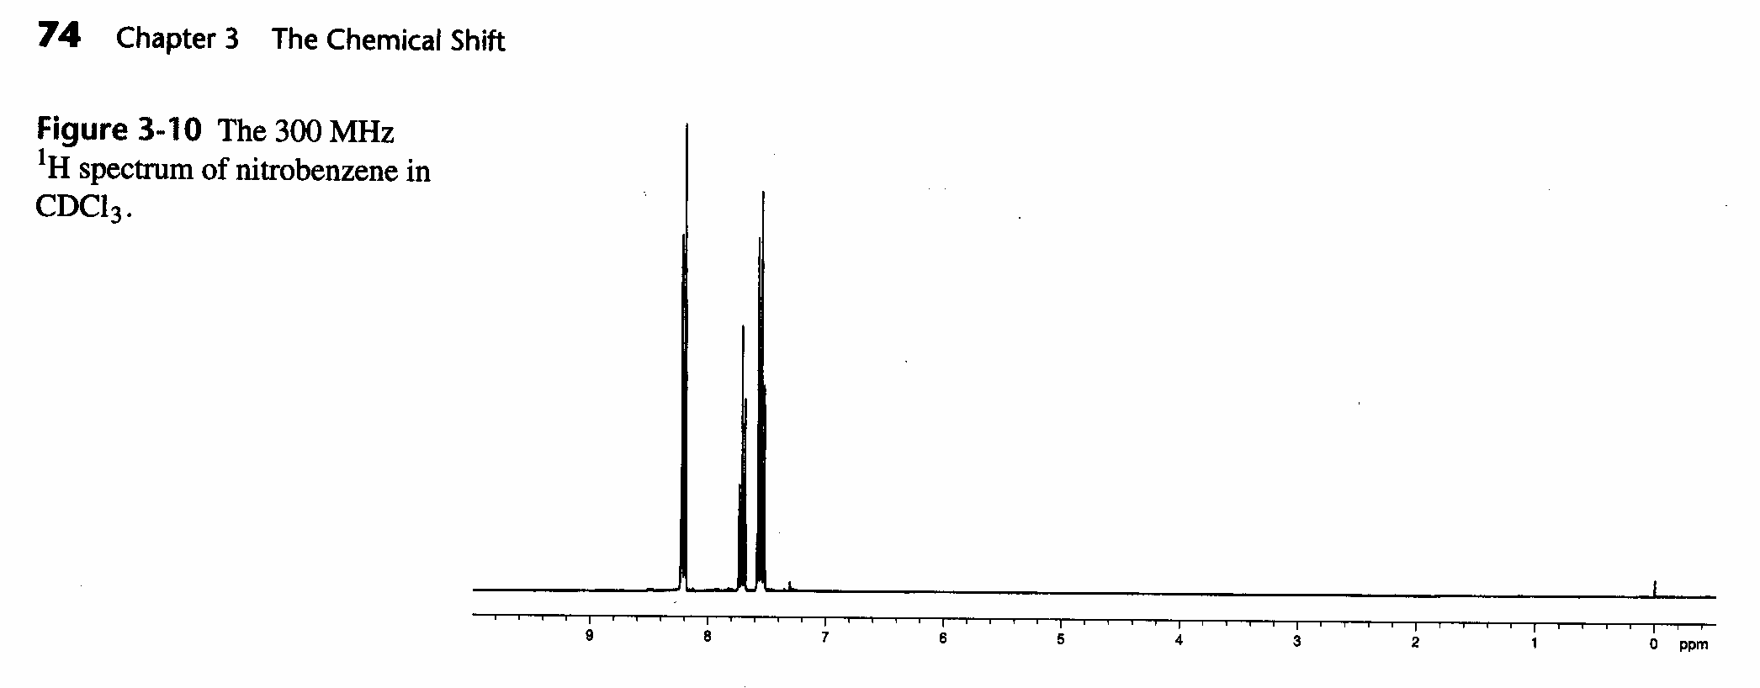
Nitrobenzene

Slide 11
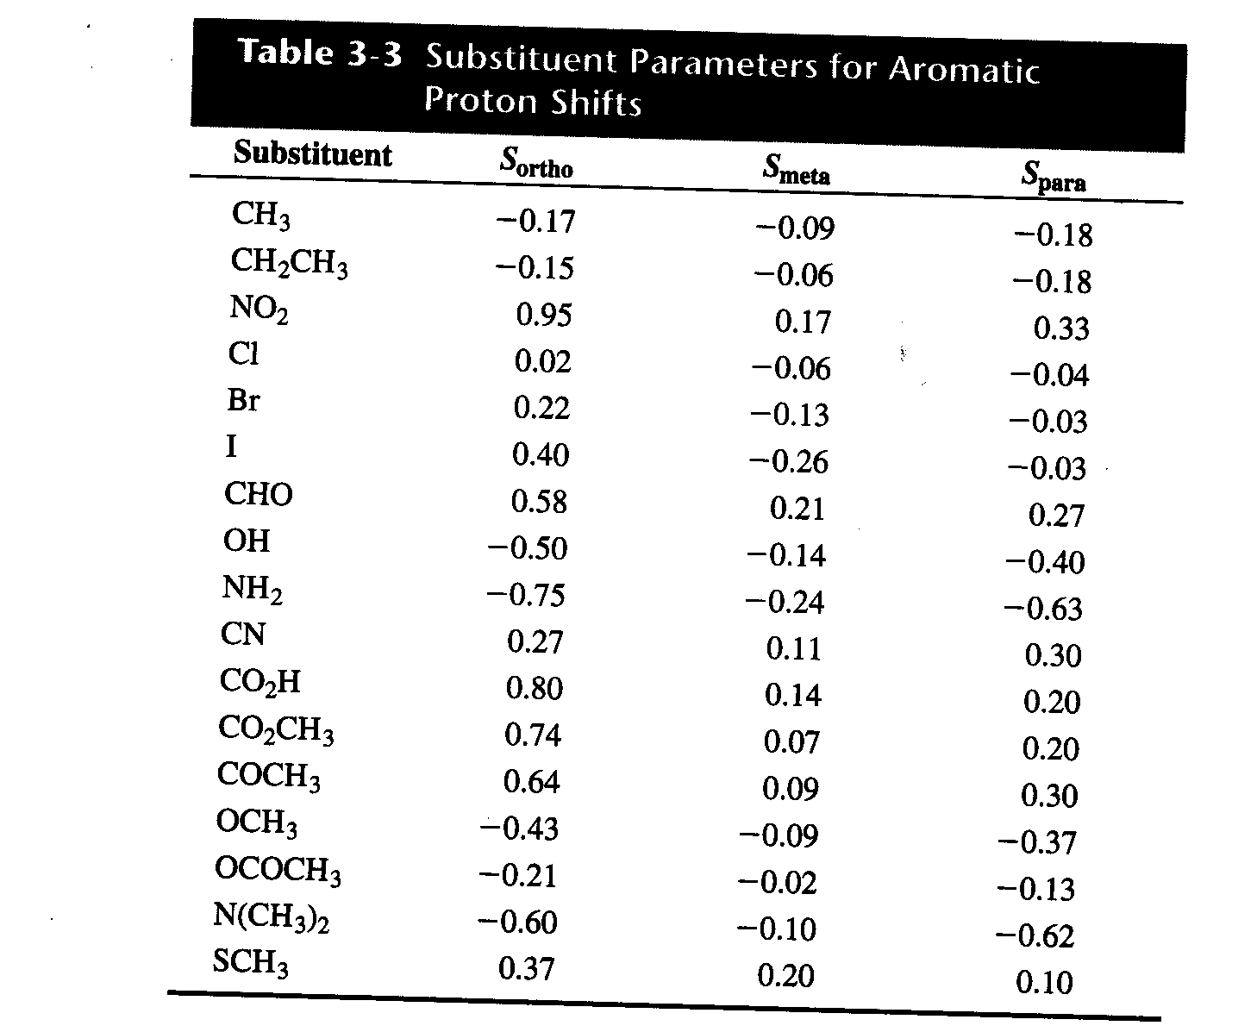

Slide 12
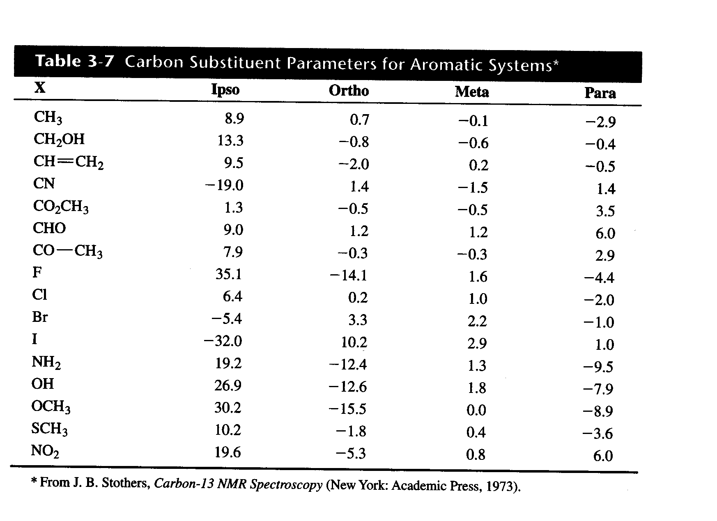

Slide 13
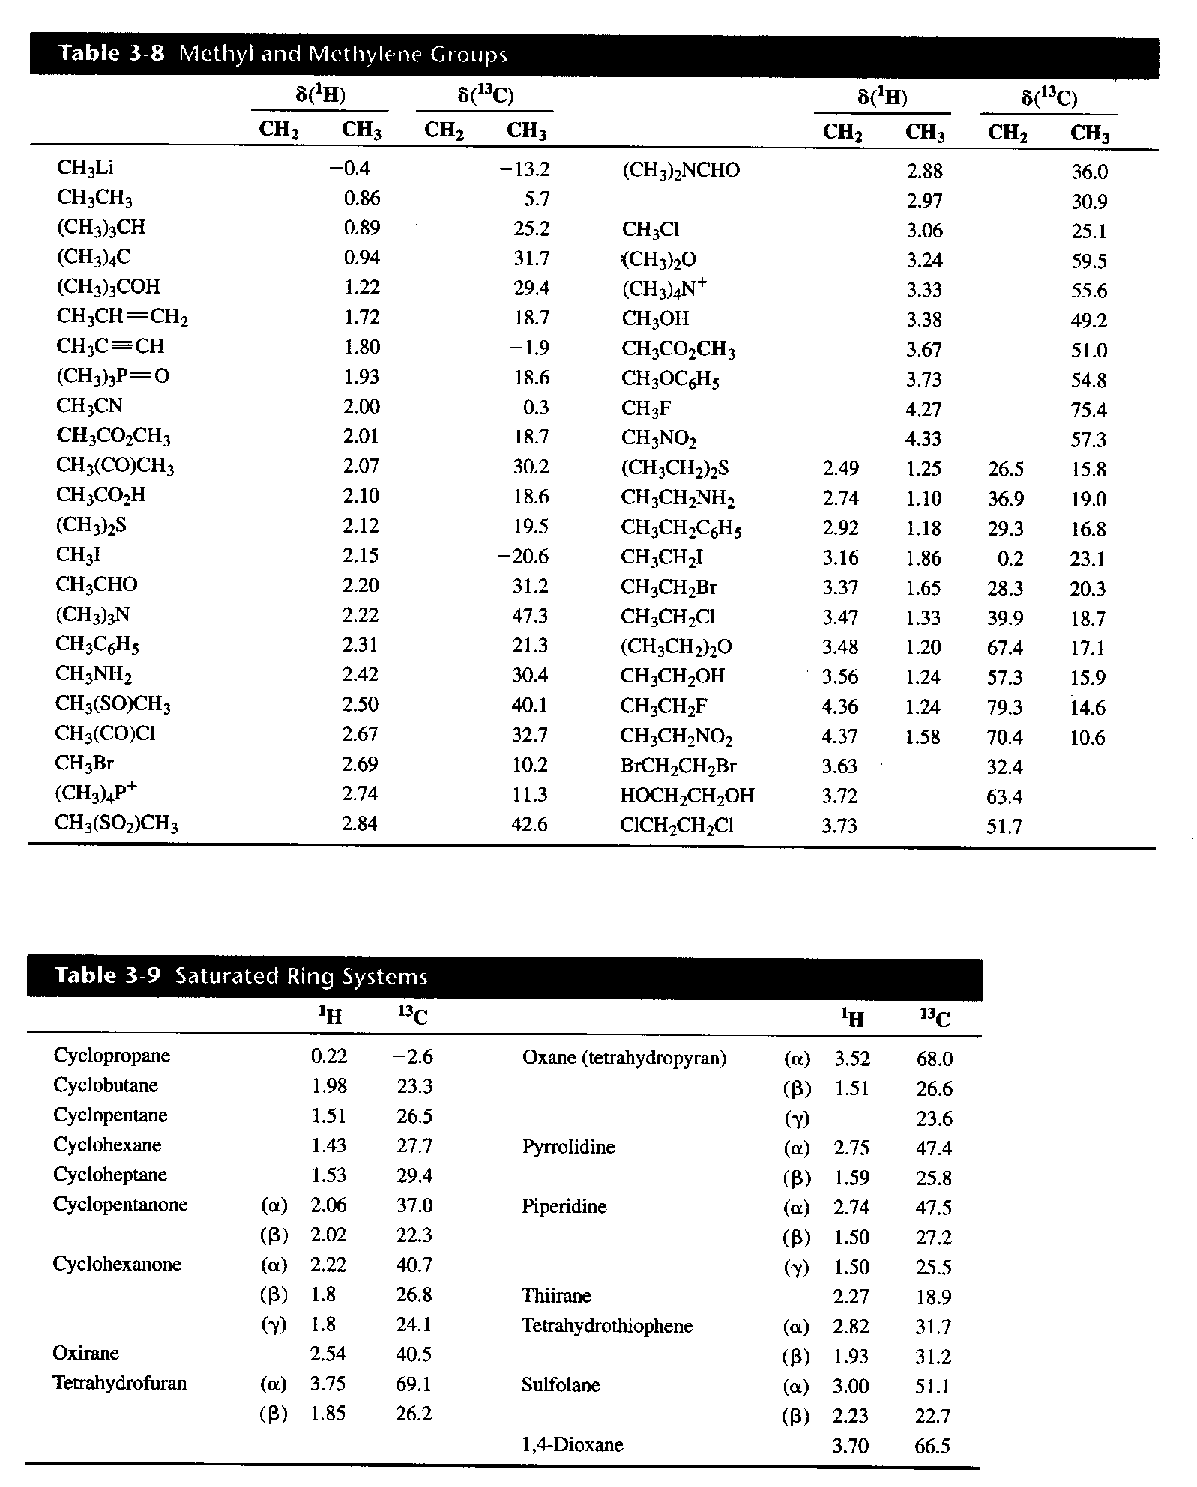

Slide 14
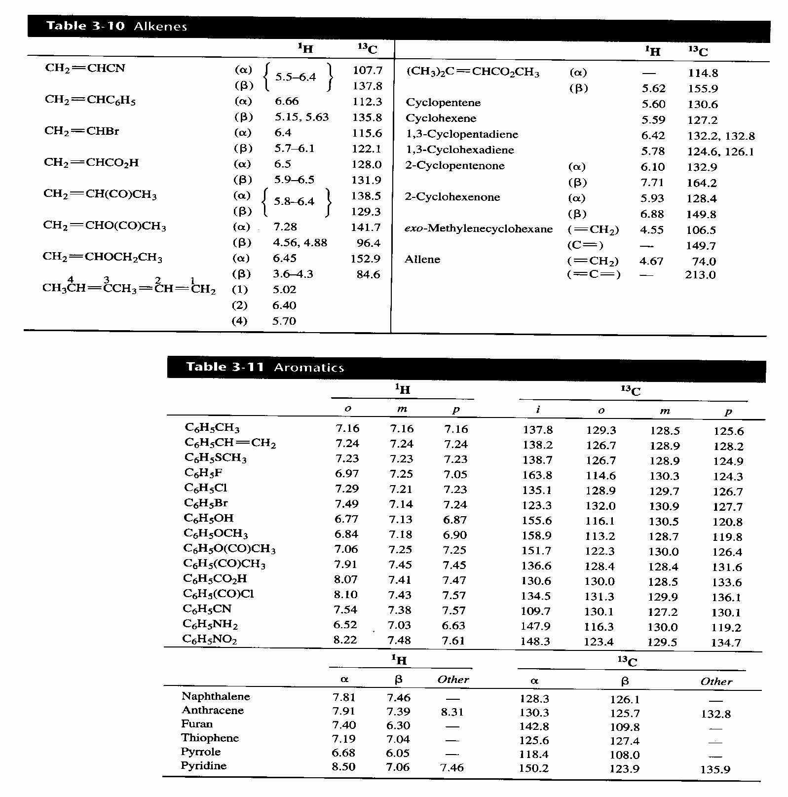

Slide 15
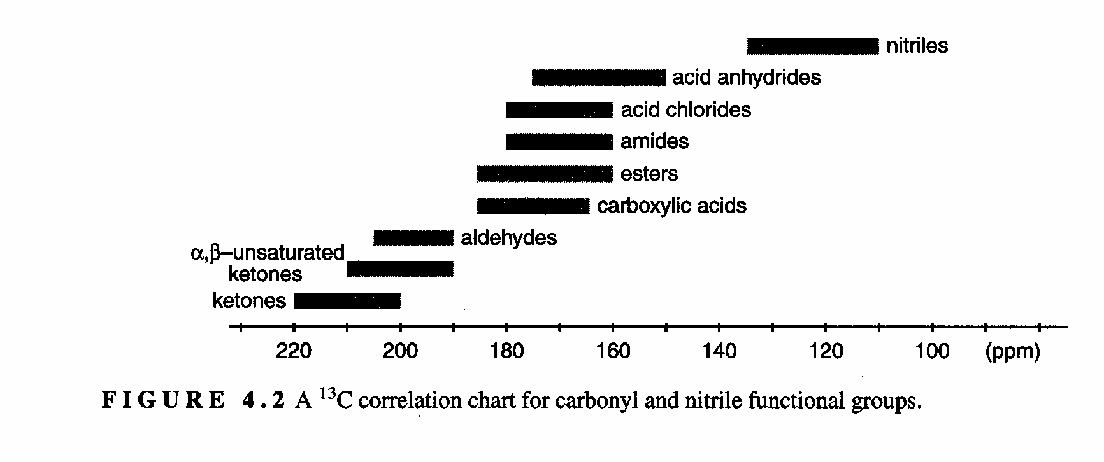
Carbonyl chemical shifts

Slide 16
Use of databases
SDBS

Slide 17
Problems for tomorrow
3.1, 3.2, 3.3 and 3.7

